Slide 1

Solving the Challenges of Rugby Club System
Higher Diploma in Science in Computing
CCT College, Dublin, Ireland
Christopher Anich
Student number: 2023202
17/05/2024

Slide 2
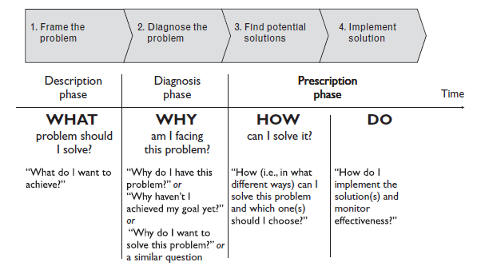
Approaching the problems
(Arnaud Chevallier, 2016)

Slide 3
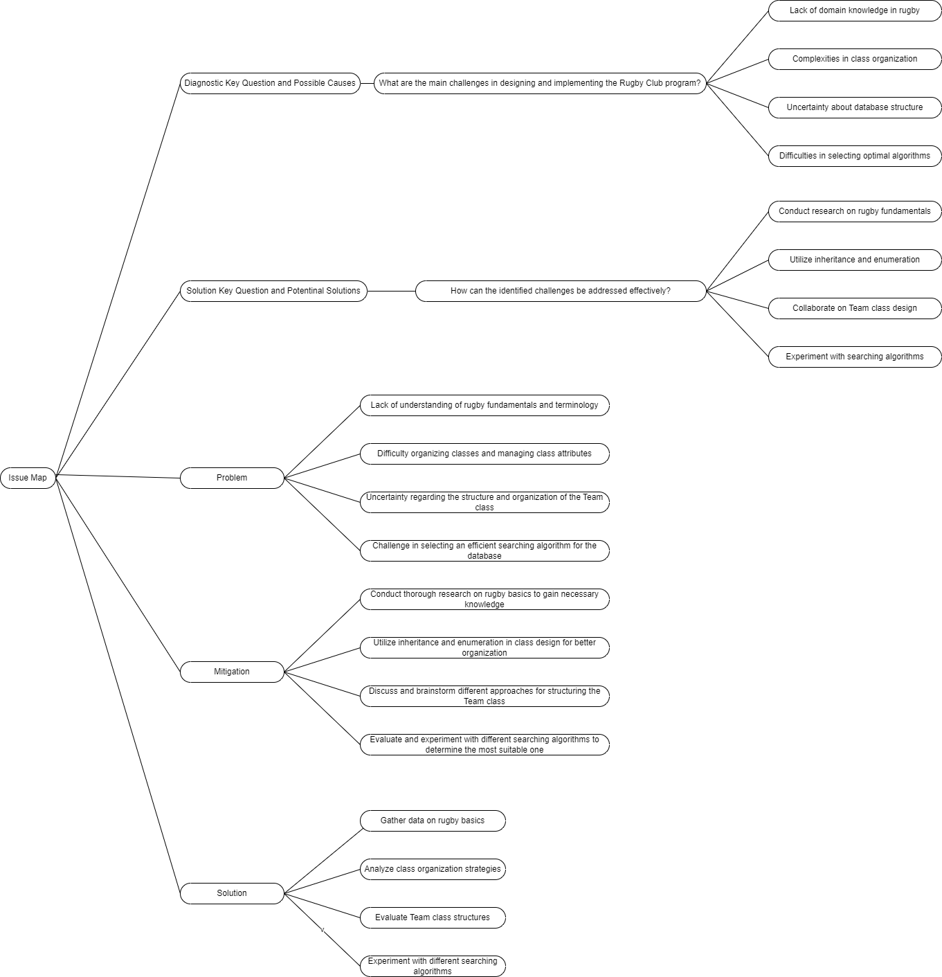
Identifying challenges
Problems could arise while managing a rugby club's database.
What were the main challenges faced in designing and implementing the Rugby Club program.
“Diagnostic Issue Map”

Slide 4
Solutions for our challenges
Education, always education!
Aternatives: Courses, certifications, consultancies, etc.
It depends on every individual case, in ours,
continuous education is the chosen one.
Why this over others?
Strengths and weaknesses of the chose approach.

Slide 5
Mitigating the Risk
Important to identify in advance key risks associated with the solution to implement
How to mitigate this?
Risk management is key

Slide 6
Next step
To prepare the development team to nail algorithms and data structures.
Plan-Do-Check-Act
(James Garza, 2024)

Slide 7
Work Cited
Arnaud Chevallier (2016). Strategic thinking in complex problem solving. Oxford ; New York: Oxford University Press.
James Garza (2024). Problem Analysis and Risk Assessment, CCT College, Dublin: Project Skills & Professionalism subject.

Slide 8
Thank you very much!
Christopher Anich
Student number: 2023202
CCT College, Dublin
17/05/2024

